Slide 1
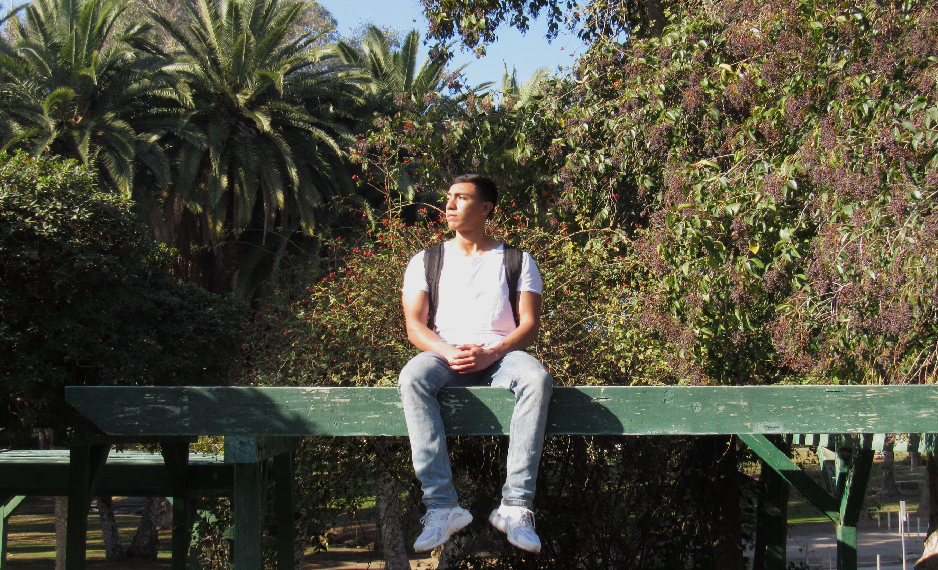
Andres Lira
Andres Lira

Slide 2
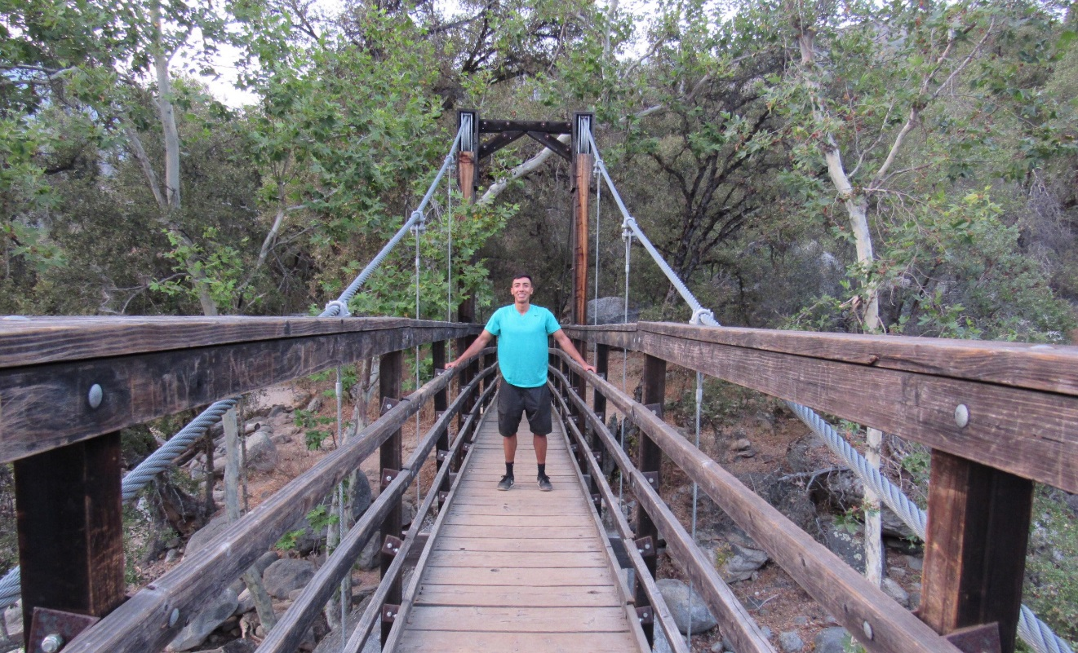
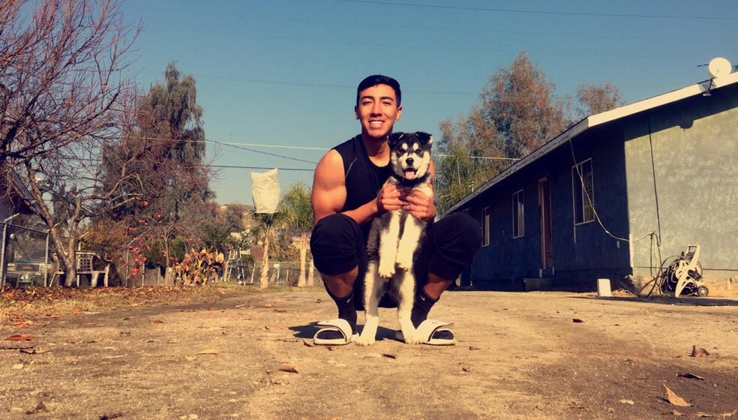
About Me
18 years of age, middle child of a family of 5
Lived in Lindsay my entire life
Passionate about fitness

Slide 3
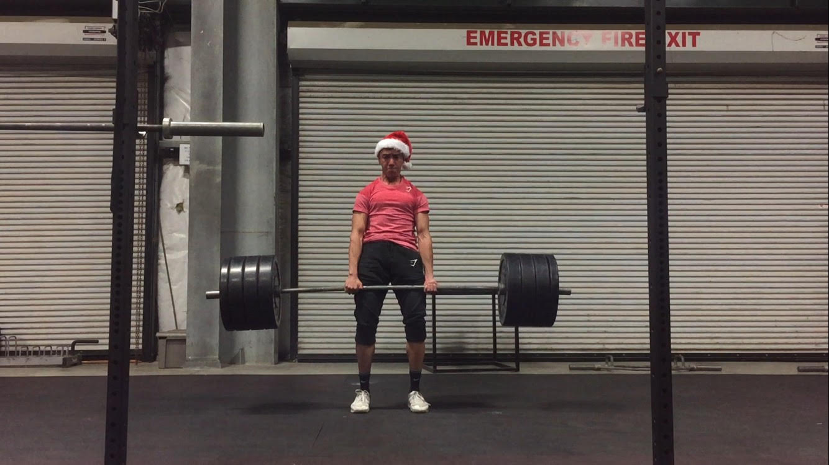
High School Experience
Played soccer my first two years of high school
Been in Art Club for 2 years
SHS since my junior year
Scicon volunteer
High school made me realize I can do anything with genuine effort

Slide 4
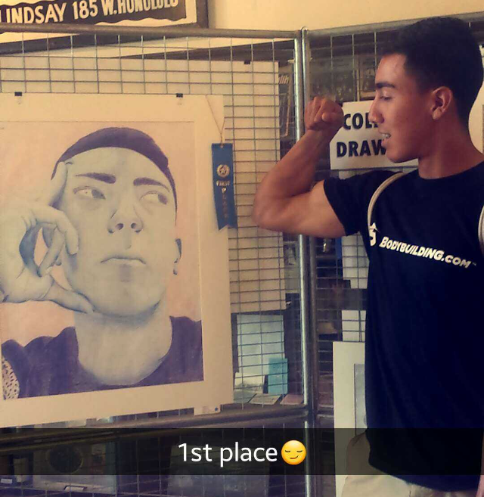
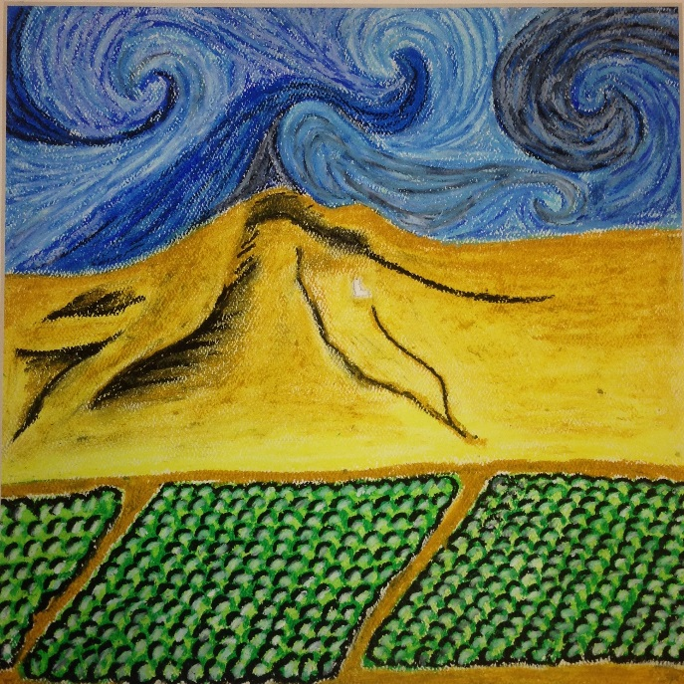
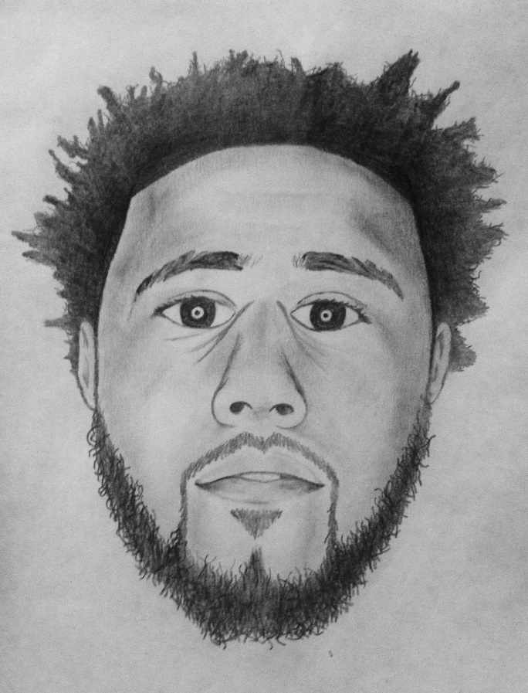
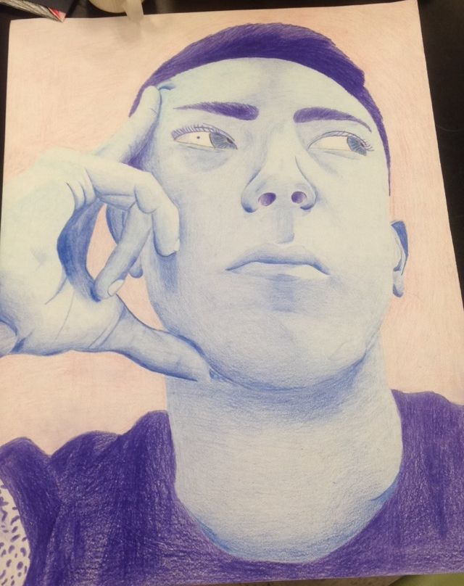
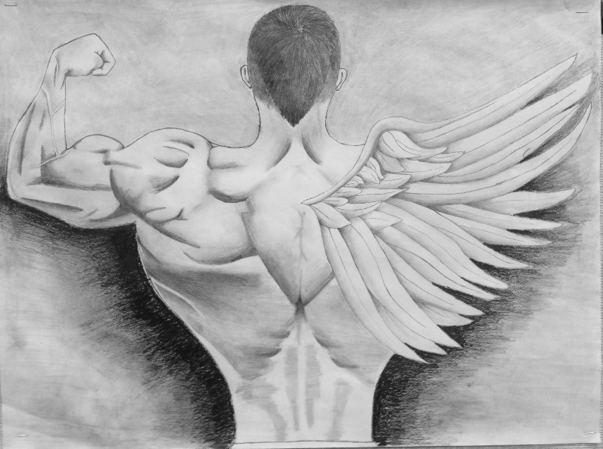
My Artwork
Won 1st place my junior year at the annual Lindsay Art Show

Slide 5
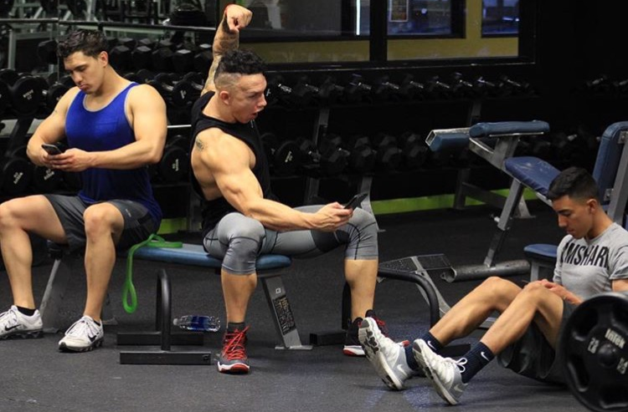
Job Shadow
Job shadowed a personal trainer/ gym operator
This perfectly fit me because I got to see a different side of the facility I train at
Got to workout at the end of my job shadow with Anthony Gonzales
Lands in the field of my interest because it revolved around fitness

Slide 6
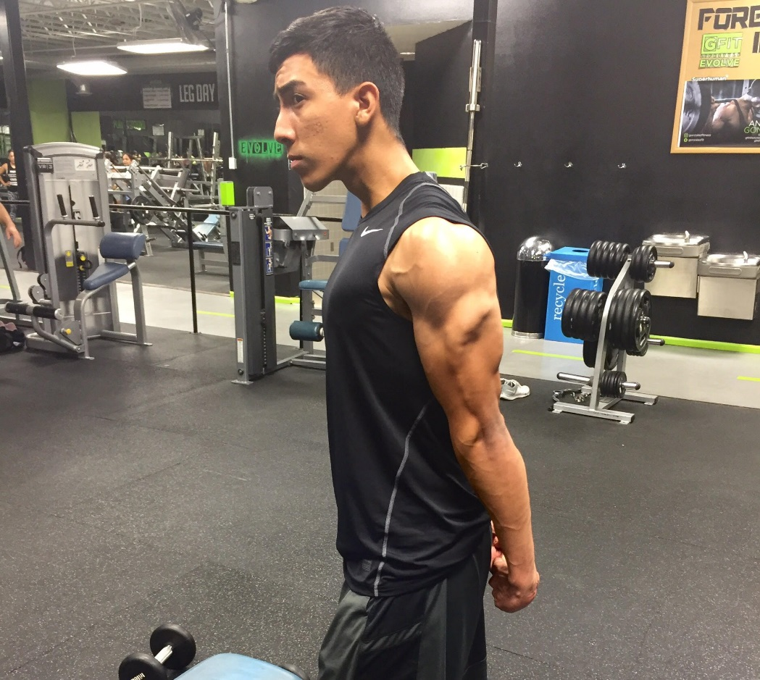
Pathway
My pathway is Sports Medicine
One year of P.E, two years of Fitness training, and one year of physiology
Suited me because it is fitness related
It taught me how to lift properly

Slide 7
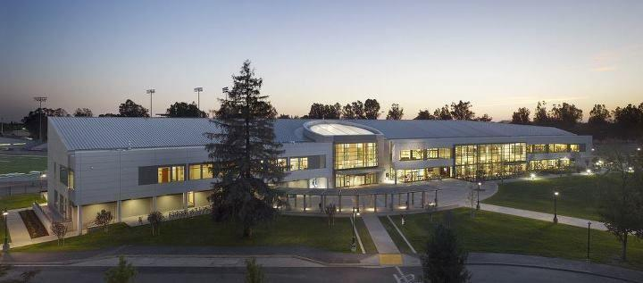
Post-High School Plans
CSU Sacramento
Majoring in Business Management
Dream is to manage my own gym
Most financial help will be FAFSA
Will be working at college

Slide 8
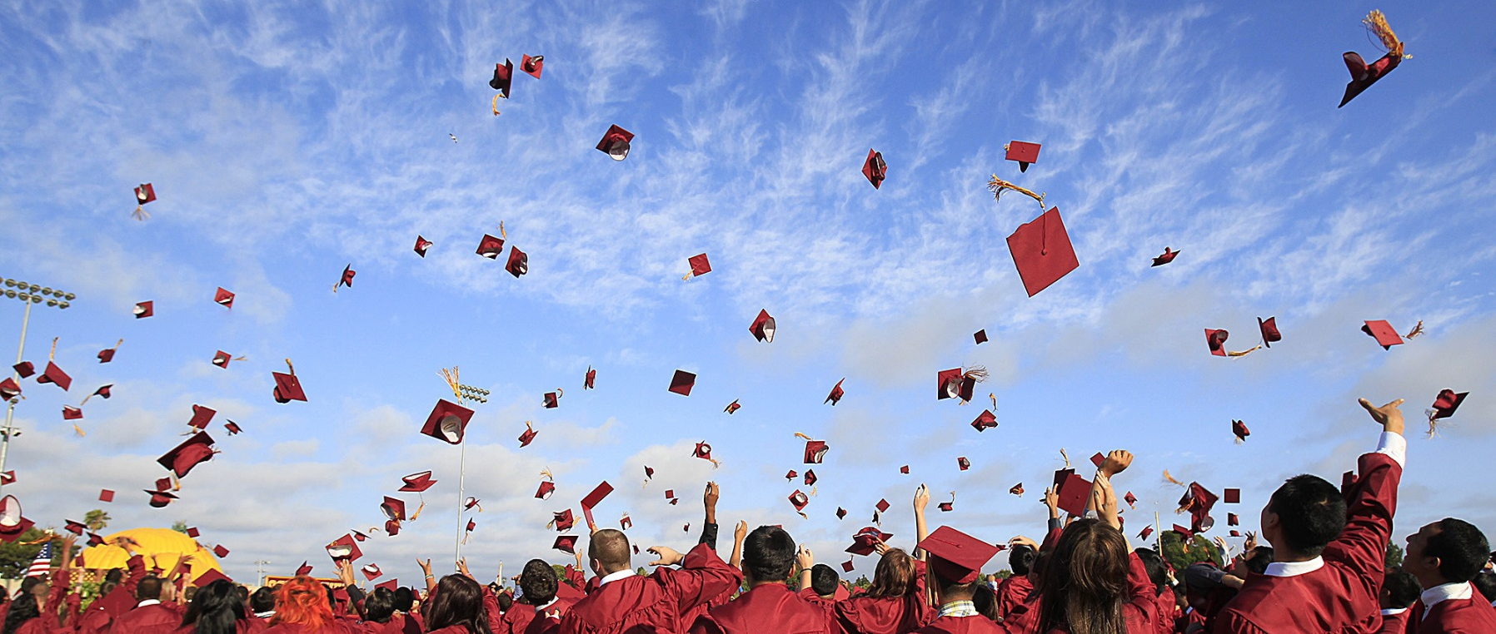
Leaving LHS
Learned that anything is accomplishable with effort
Endless opportunities surround us daily
PBS taught me to take more responsibility with my school work

Slide 9
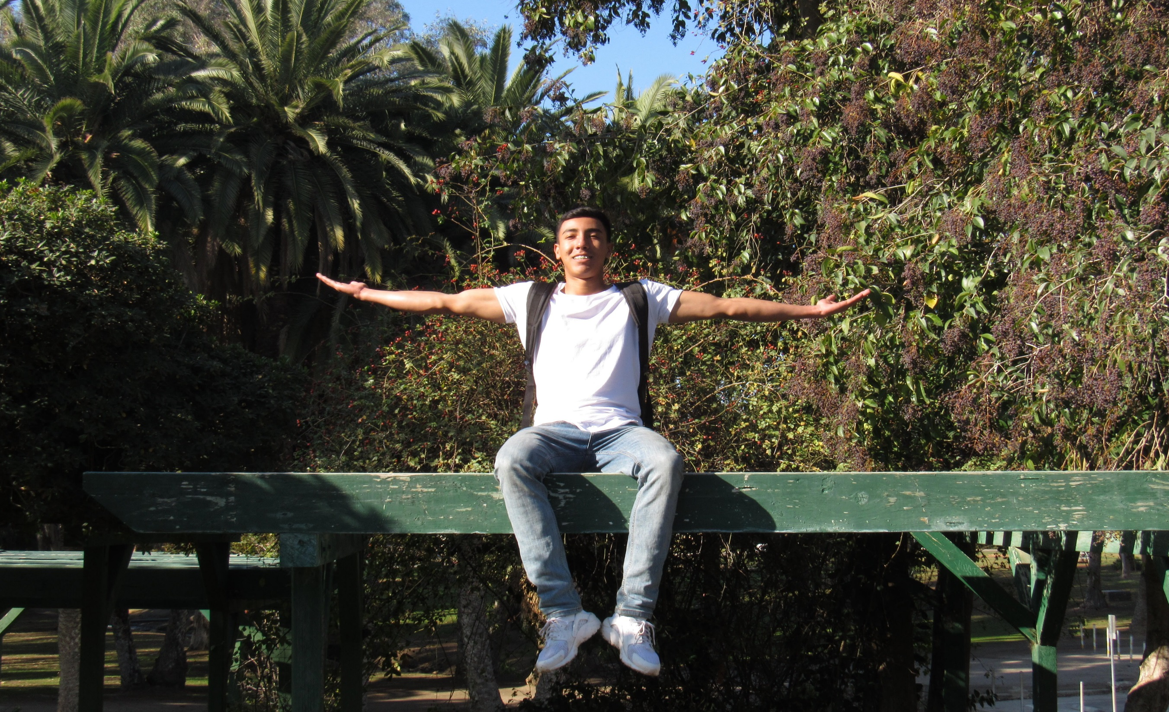
Any Questions?

